Slide 1
functions
Guoqiang Zhang
Reference book: “Introduction to Python Programming Course Notes”, Phil Spector, University of California Berkeley

Slide 2
Motivation for using functions
Functions allow us to logically group statements that performs a specific task.
Benefits for using functions
Code reuse
Human readability of the code
Easy to debug
Two types of functions
Predefined – e.g., len, min, max, range, type, id
User-defined - you write the function definition, and you use it. Possibly will become a predefined function to someone else.

Slide 3
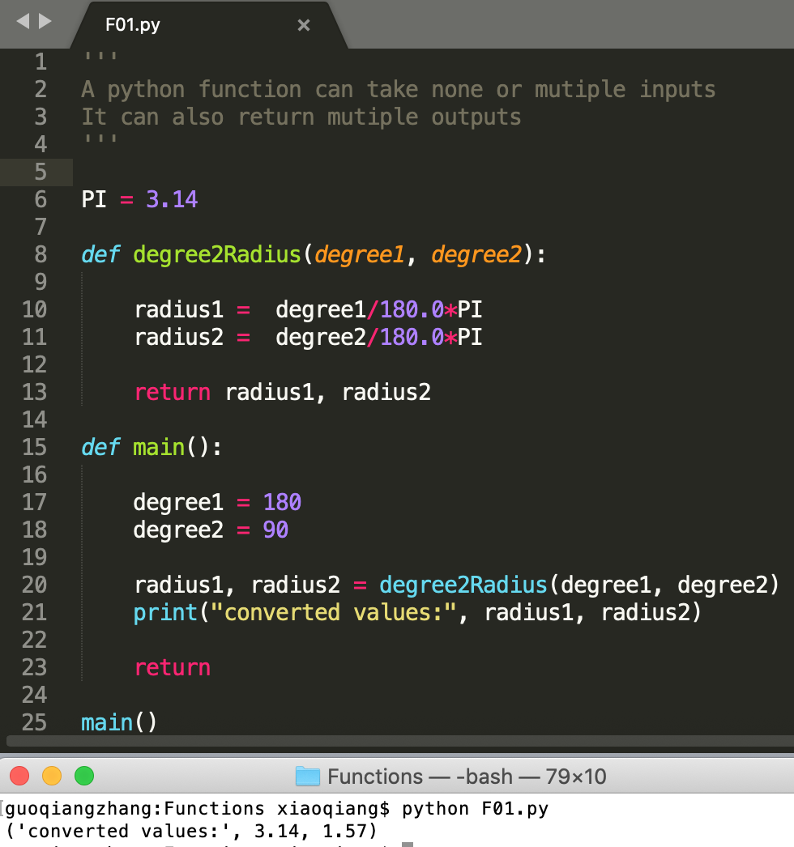
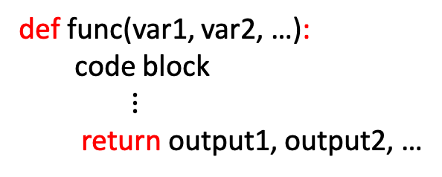
Function definitions
Syntax:
Remark:
def func(var1, var2, …):
code block
$⋮$
return output1, output2, …
A function in Python can take none or multiple input arguments.
A function in Python can return none or multiple outputs.
Different from C language.

Slide 4
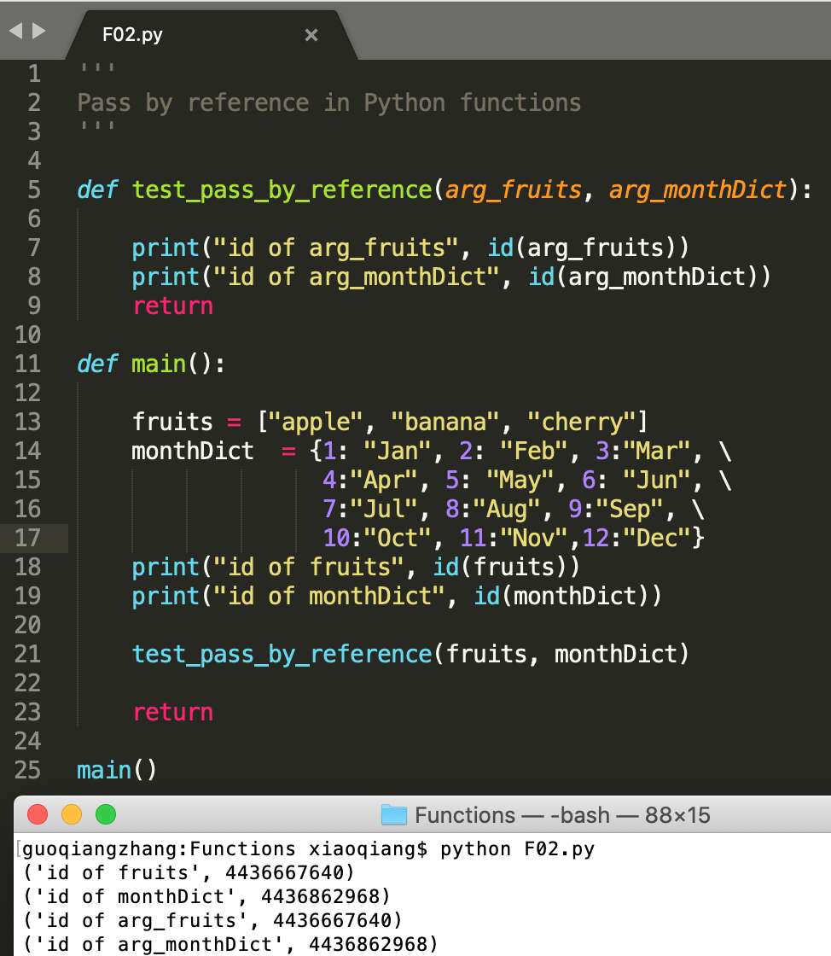
Function properties (1)
Pass by reference in Python functions
The inputs are passed to python functions without making a local copy.
Different from C language, where inputs are passed by making a local copy.

Slide 5
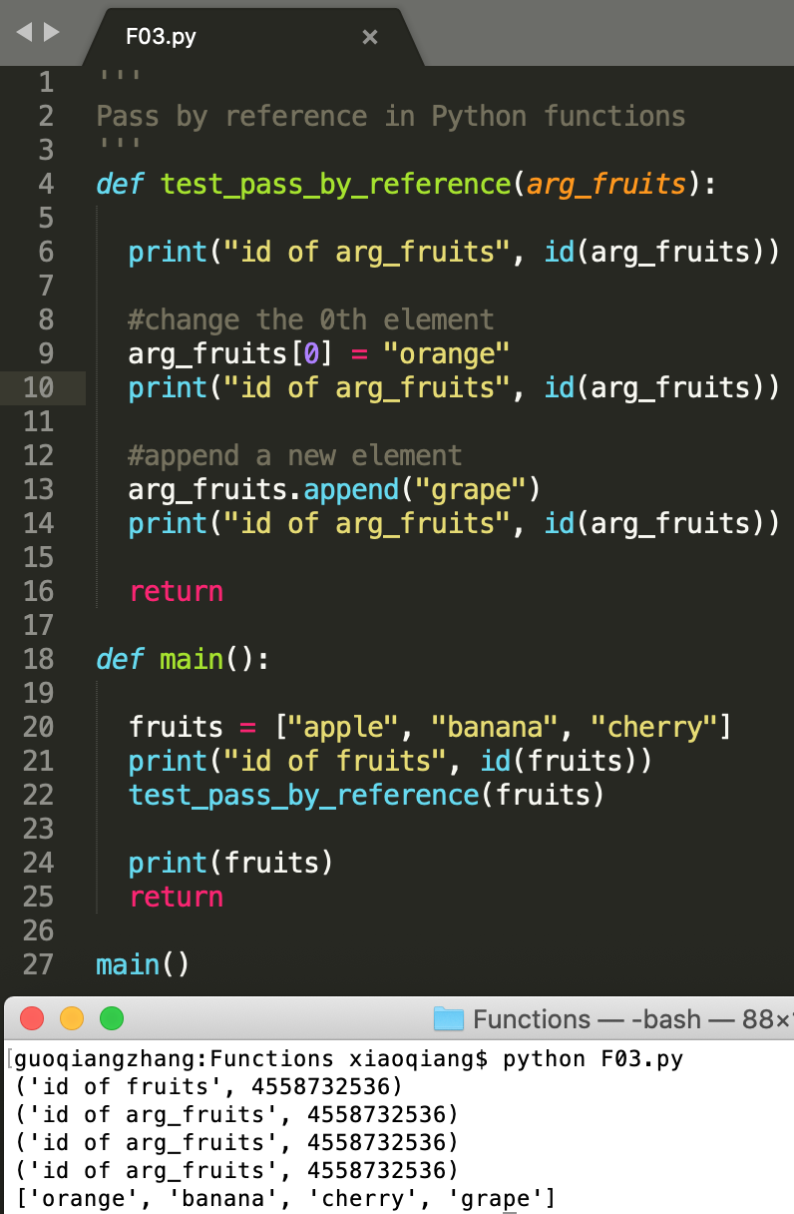
Function properties (2)
Pass by reference in Python functions
Manipulate inputs inside a function will affect the original inputs
Be careful when input arguments are manipulated inside a function.

Slide 6
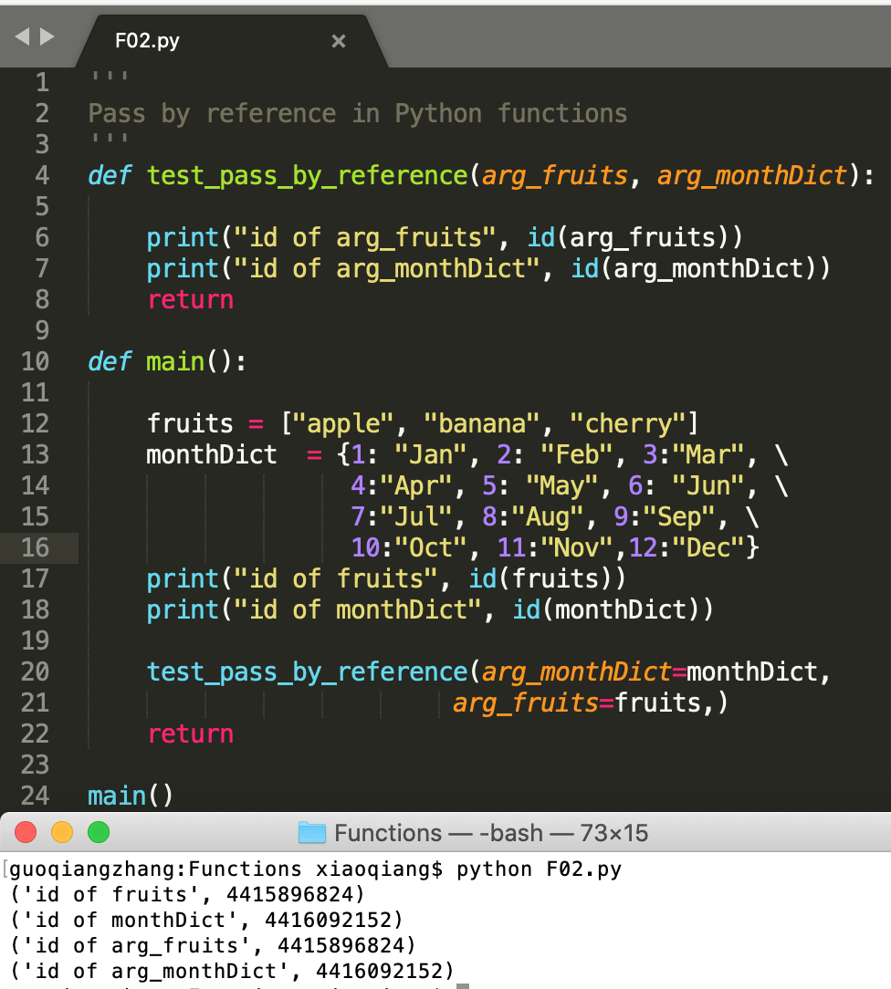
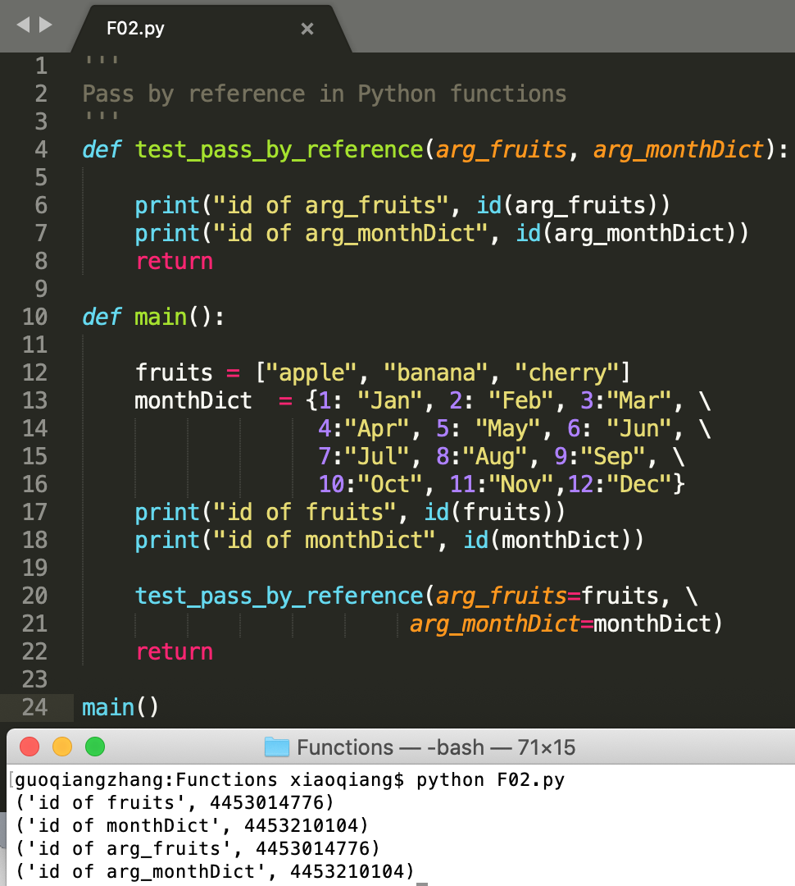
Function properties (3)
Calling a function by specifying argument names (Argument order does not matter)

Slide 7
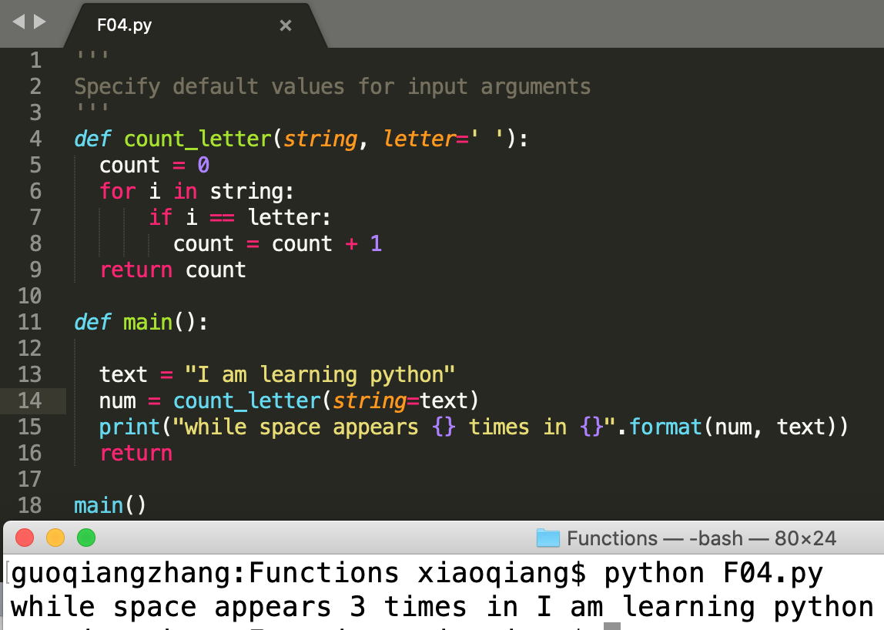
Function properties (4)
Specify default values for input arguments

Slide 8
Exercises (1)
Write a program to get a circle radius from terminal, and then compute the area of the circle by a function (See F05.py)
The function input() can be used to get a string from terminal. Convert a string to float value by using float()

Slide 9
Exercises (2)
Write a program to repetitively get strings from terminal until the input string is "stop". Only new strings are kept and put into a list (See F06.py)
The function input() can be used to get a string from terminal.

Slide 10
Exercises (3)
Write a function to repetitively get positive integers from terminal until the input integer is ”0". Only new integers are kept and put into a list. The function returns the list as well as the sum and product of the elements in the list (See F07.py)
The function input() can be used to get a string from terminal. Convert a string to interger value by using int()

